Slide 1
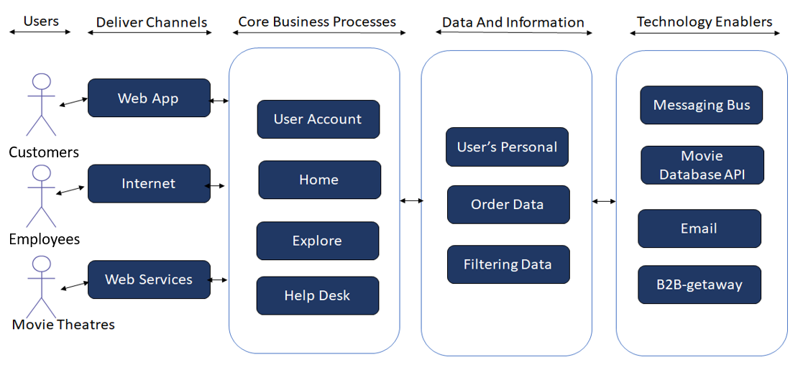
Application: MLDB
Type: Application Architecture
View: Logical View
Style: Layered Architecture Pattern

Slide 2
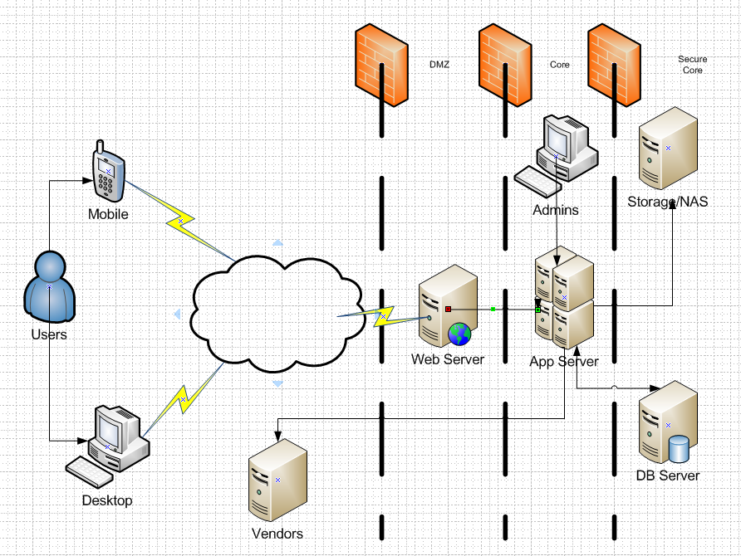
Application: MLDB Type: Application Architecture View: Process View Style: Client-Server Pattern
web

Slide 3
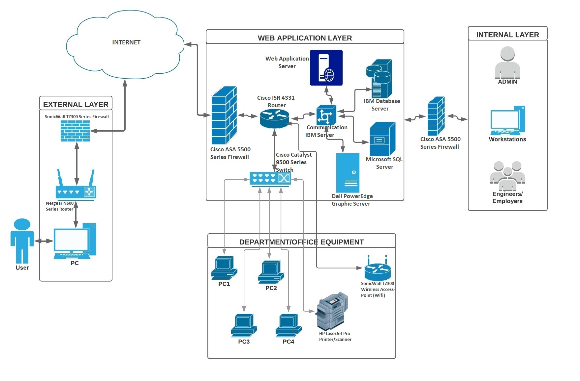
Application: MLDB Type: Application Architecture View: Physical View Style: Layered Architecture Pattern

